Slide 1
2024-2025 Annual Title I Meeting
South County Career Acceleration Academy
Principal: Mrs. Jennifer Woods
Date: Monday, August 26, 2024

Slide 2
Agenda
What is Title I?
Parent’s Rights Under Title I
Parent & Family Engagement Plan
School-Parent-Student Compact
School Achievement Data
Title I Funds

Slide 3
What Is Title I?
English
Spanish

Slide 4
Parent’s Right to Know
As a parent of a student who attends a public school in Hillsborough County, you have the right to know the professional qualifications of the teachers or paraprofessionals who teach your child.
Federal law allows you to obtain certain information about your child's teachers or paraprofessionals and requires us to provide you with that information upon request.
More information is provided in our Notice to Parents

Slide 5
Parent & Family Engagement Plan
Every Title I school, in collaboration with parents, must develop a school parent involvement plan.
The plan describes how the school will engage the families in an organized, ongoing, and timely way in the planning, review and improvement of the Title I program at the school.
A copy of the plan will be on our school’s website, in the Parent Information Notebook in the front office, and available for you to take home today.

Slide 6
School-Parent-Student Compact
A written agreement that outlines how the parents, the entire staff and the students will share the responsibility for improved student academic achievement, as well as describes how the school and parents will build and develop a partnership that will help children achieve the state’s high standards.
A copy of the Compact will be on our school’s website, in the Parent Information Notebook in the front office, & available for you to take home today.

Slide 7
School Achievement Data

Slide 8
Title I Funds
Federal Programs Projected 2024-2025 Title I Budget Allocation
School Name: | So County Career Ctr
School #: | 4154
Contact Name: | Jennifer Woods
Phone Number: | 813-233-3335
 | 2024-2025 Preliminary School Allocation
 | Survey 3 - Preliminary |  |  |  | Direct Cert | MEM | Percent Eligible
 |  |  |  |  | 55 | 73 | 75.34%
 |  |  |  |  | # Direct Cert Students | Per Child Rate | Title I Preliminary Allocation
 |  | Tier 1 (100%-75%) |  |  | 55 | $ 800.00 | $44,000
 |  |  |  |  |  | Title I Allocation | $44,000
 |  |  |  |  |  | PFE Allocation | $5,000

Slide 9
School Poverty Data
Our school’s Title I allocation for the 2024-2025 school year is $44,000 (total allocation)
Title I Parent & Family Engagement Set Aside is $5,000
We are using our funds in the following ways:
Student academic activities
Field trips
Classroom Supplies
Professional Development
Family Engagement Activities

Slide 10
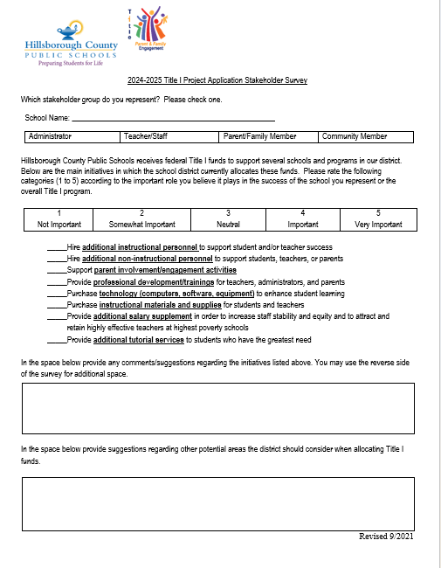
How Can You Help Decide How Funds are Spent?
Project Application Survey
Join SAC

Slide 11
Important Dates
Information will be sent home by students, sent by email via ParentLink, posted on our website, and follow us on Facebook & Instagram @southcountycc
Family Nights/Parent-Teacher Conferences
Oct 17 We Are Connected 3:00pm – 7:00pm
SAC & PTSO Meeting Dates
Last Tuesday of each month (virtual 3:00pm – 4:00pm)
Parent Meetings
Parent Workshop/Training Sessions
Other Events

Slide 12
Questions?

